Slide 1


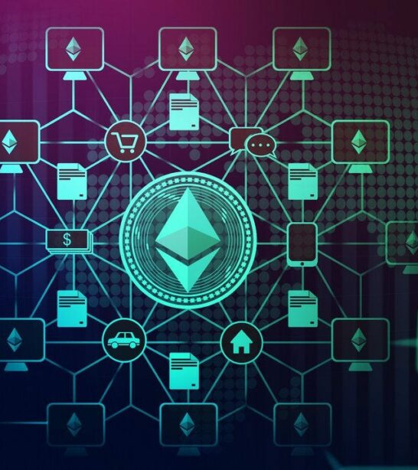
SentinelAI: AI-Powered Smart Contract Security BlockDAG Hackathon 2025
By Team: Phulera
Theme: AI + Smart Contracts

Slide 2




The Problem Statement
Smart contract vulnerabilities are a persistent and costly threat in the blockchain ecosystem, leading to billions in lost funds. Current auditing processes are often manual, time-consuming, expensive, and reactive, struggling to keep pace with the rapid deployment of new contracts and sophisticated attack vectors. There's a critical need for a proactive, scalable, and intelligent security solution.

Slide 3


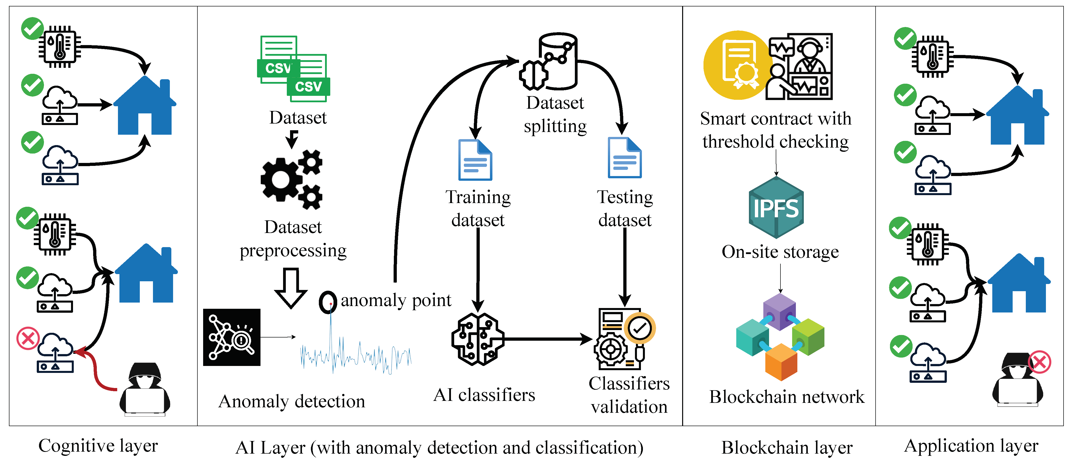

Our Innovative Solution: SentinelAI
We propose SentinelAI, a decentralized application that integrates Artificial Intelligence to provide comprehensive smart contract security. SentinelAI utilizes machine learning models to proactively identify vulnerabilities in contract code pre-deployment and to detect anomalous, potentially malicious patterns in on-chain transaction data in real-time. This offers both preventative and active monitoring capabilities.

Slide 4
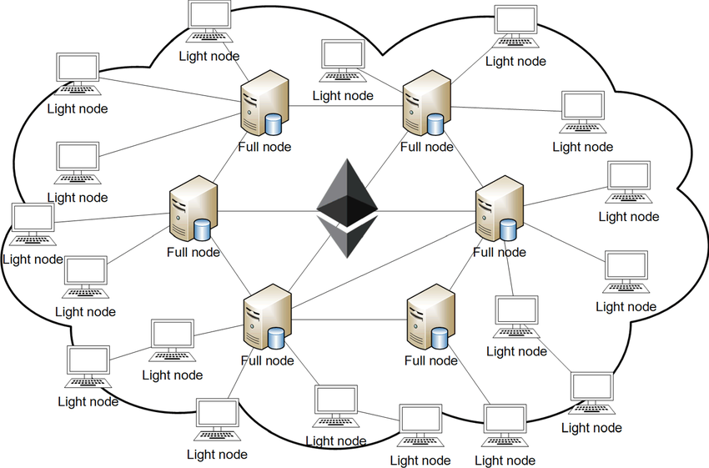
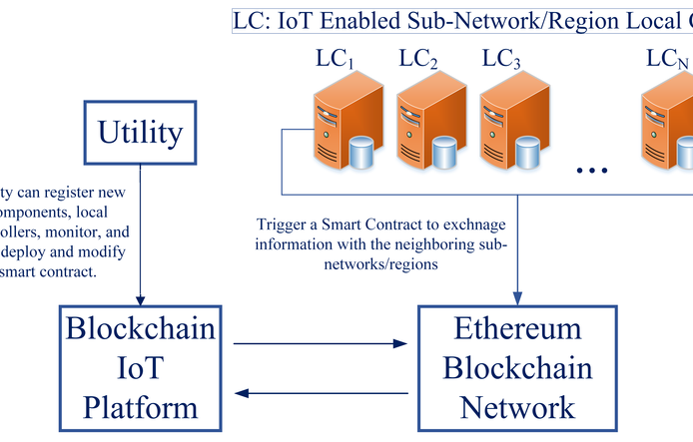
Technical Architecture & Key Features
SentinelAI is built on a robust architecture designed for efficiency and scalability.
Blockchain: Ethereum (EVM-compatible for broad dApp integration)
Smart Contracts: Solidity for core dApp logic, user interaction, and potentially a governance model
AI/ML Core: Python (TensorFlow/PyTorch) for training and deploying AI models that analyze code patterns and on-chain behavior
Frontend: React.js for an intuitive, responsive, and secure user dashboard
Key Features: Automated vulnerability scanning, real-time threat alerts, historical risk assessment, and a user-friendly security dashboard.

Slide 5
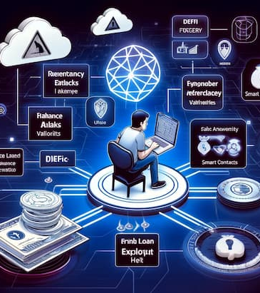
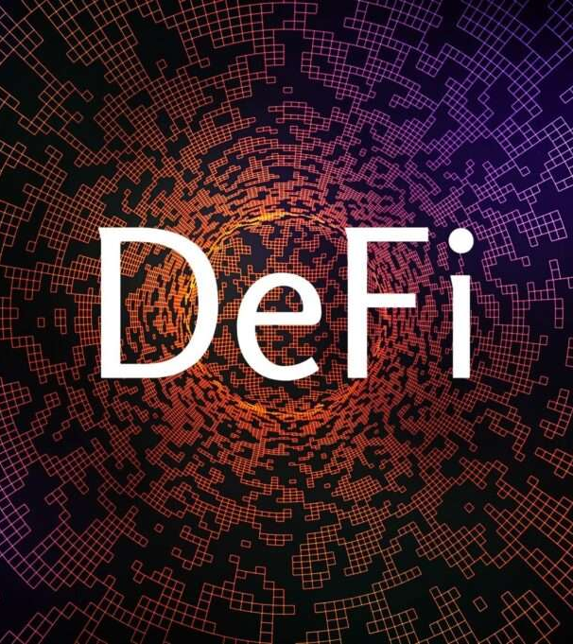
Who Benefits & Why It Matters
SentinelAI provides crucial value across the blockchain ecosystem, fostering a more secure and trustworthy environment.
Users: Smart contract developers, dApp development teams, DeFi protocols, and independent blockchain auditors.
Benefit 1: Significantly reduces the time and cost associated with manual security audits.
Benefit 2: Proactively identifies critical vulnerabilities and suspicious activities, minimizing financial losses from exploits.
Impact: Enhances overall blockchain security, accelerates the dApp development lifecycle, and builds greater trust in decentralized applications.

Slide 6
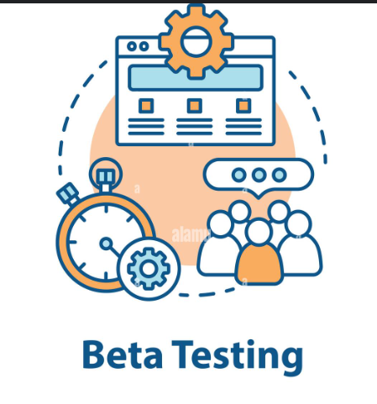

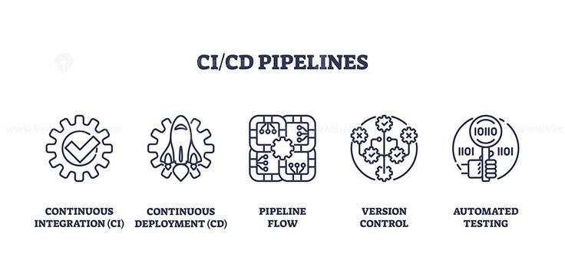
What's Next: Post-Hackathon Roadmap
Our vision for SentinelAI extends far beyond this hackathon, aiming for continuous improvement and broader adoption.
Phase 1 (Post-Hackathon): Conduct closed beta testing with early adopter developers to gather feedback and further refine our AI models.
Phase 2 (Mid-term): Integrate SentinelAI with popular CI/CD pipelines and expand AI model capabilities to support additional smart contract languages and incorporate formal verification techniques.
Long-term: Establish a decentralized governance model for AI model updates and protocol improvements, and explore integrations with blockchain insurance protocols to become the industry standard for smart contract security.

Slide 7
Thank You

